Slide 1

2019 Review and Updates to
Microsoft Teams
This Photo by Unknown Author is licensed under CC BY-SA

Slide 2
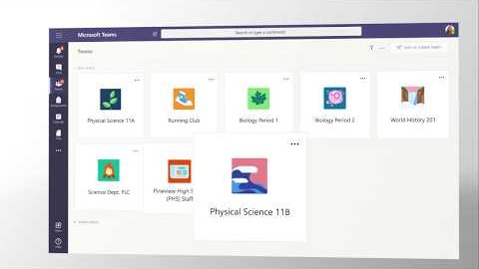
Introduction
Notes:
Show intro video

Slide 3
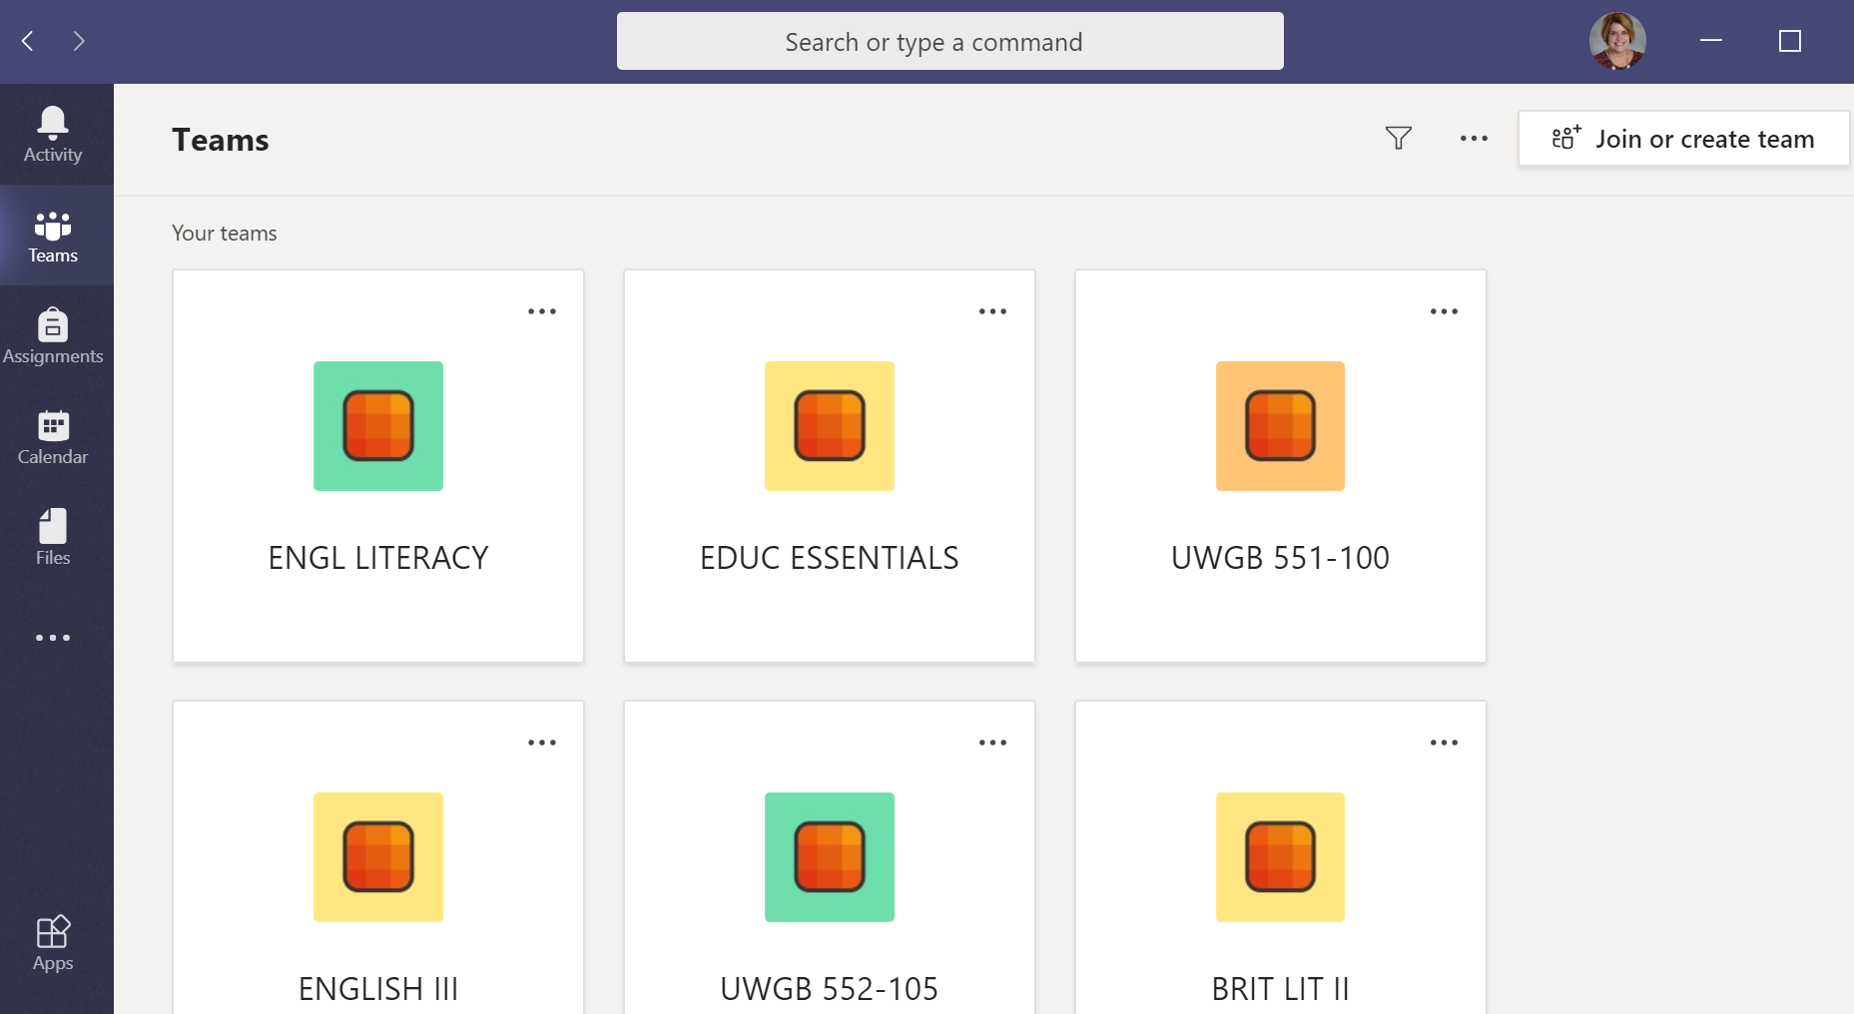
New Look
Classes are set up as tiles in a grid
Notes:
When you open Teams this year, you will see a new look. Your classes are set up as tiles in a grid. You can drag the tiles around to put your current classes at the top.

Slide 4
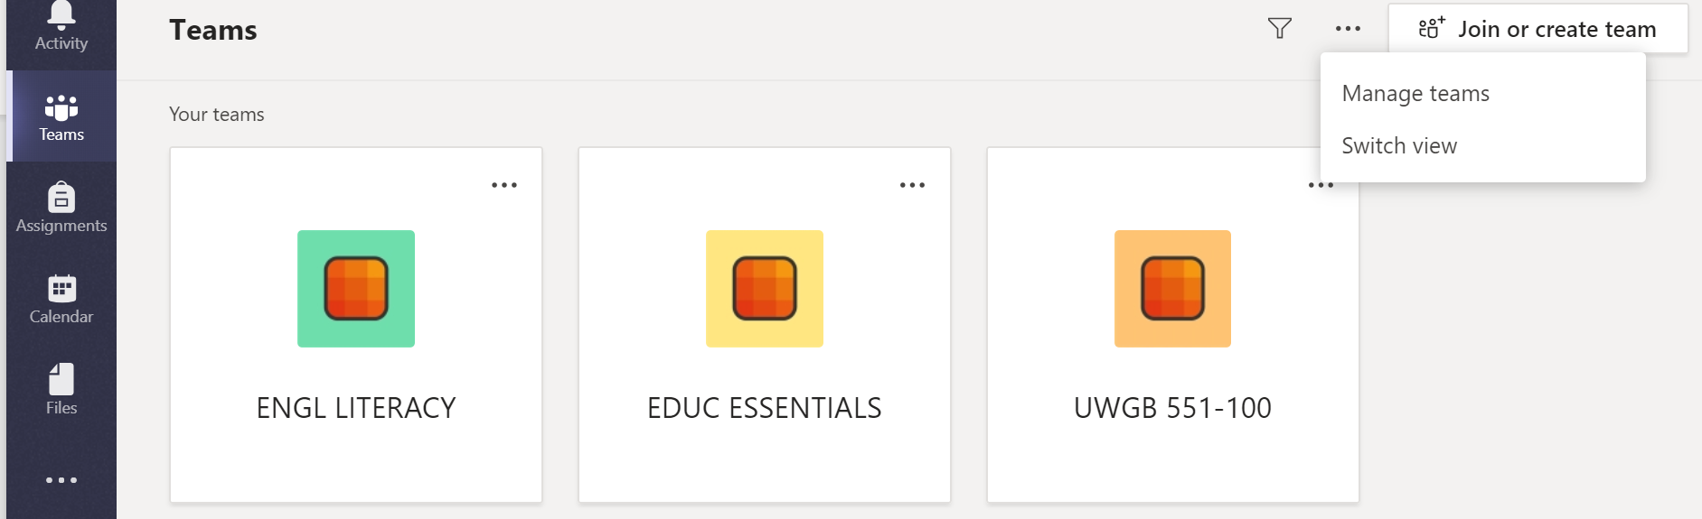
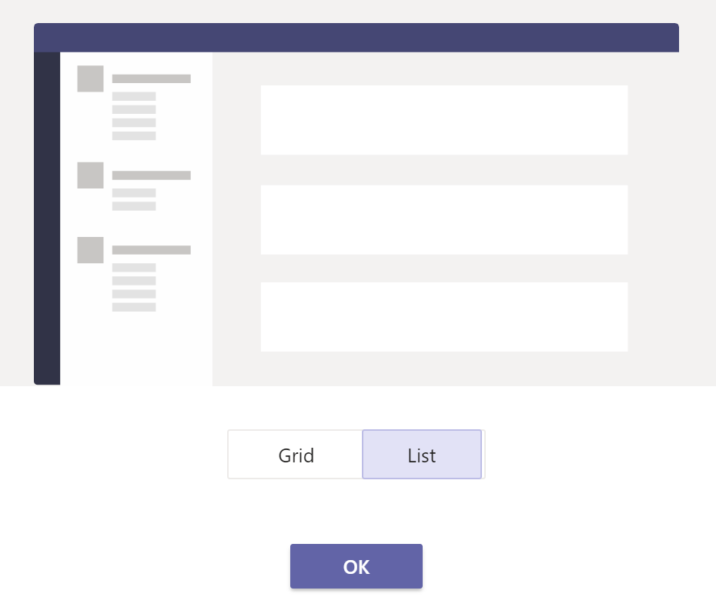
Change to a List
Click the three dots at the top of the Teams page
Choose “Switch view”
Select “List”
Notes:
If you want to revert to the old style, just click the three dots at the top of the page. You will get an option to “Switch View” and then select “List.”

Slide 5
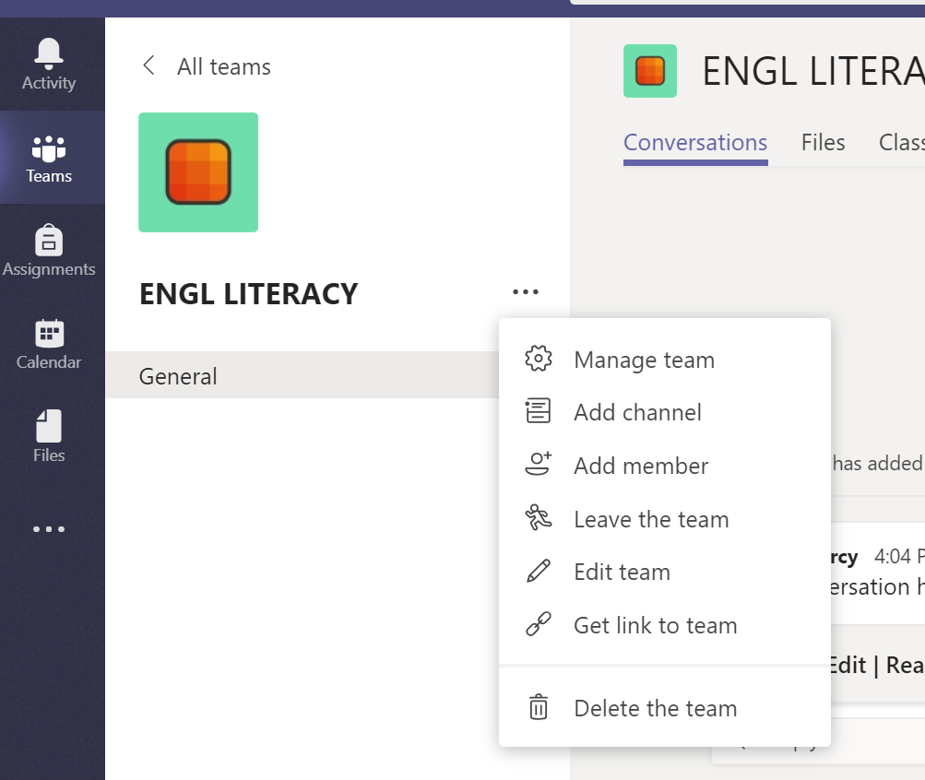

Changing the Name of Your Class
If you teach multiple classes with the same name
  Change the class name or add the term and hour
  Choose an icon to differentiate your classes
Notes:
If you teach multiple classes with the same name, you can change the name of your class. Click on the class you want to change. Look for the three dots and click on them. From the menu, choose “Edit team.” Next slide

Slide 6
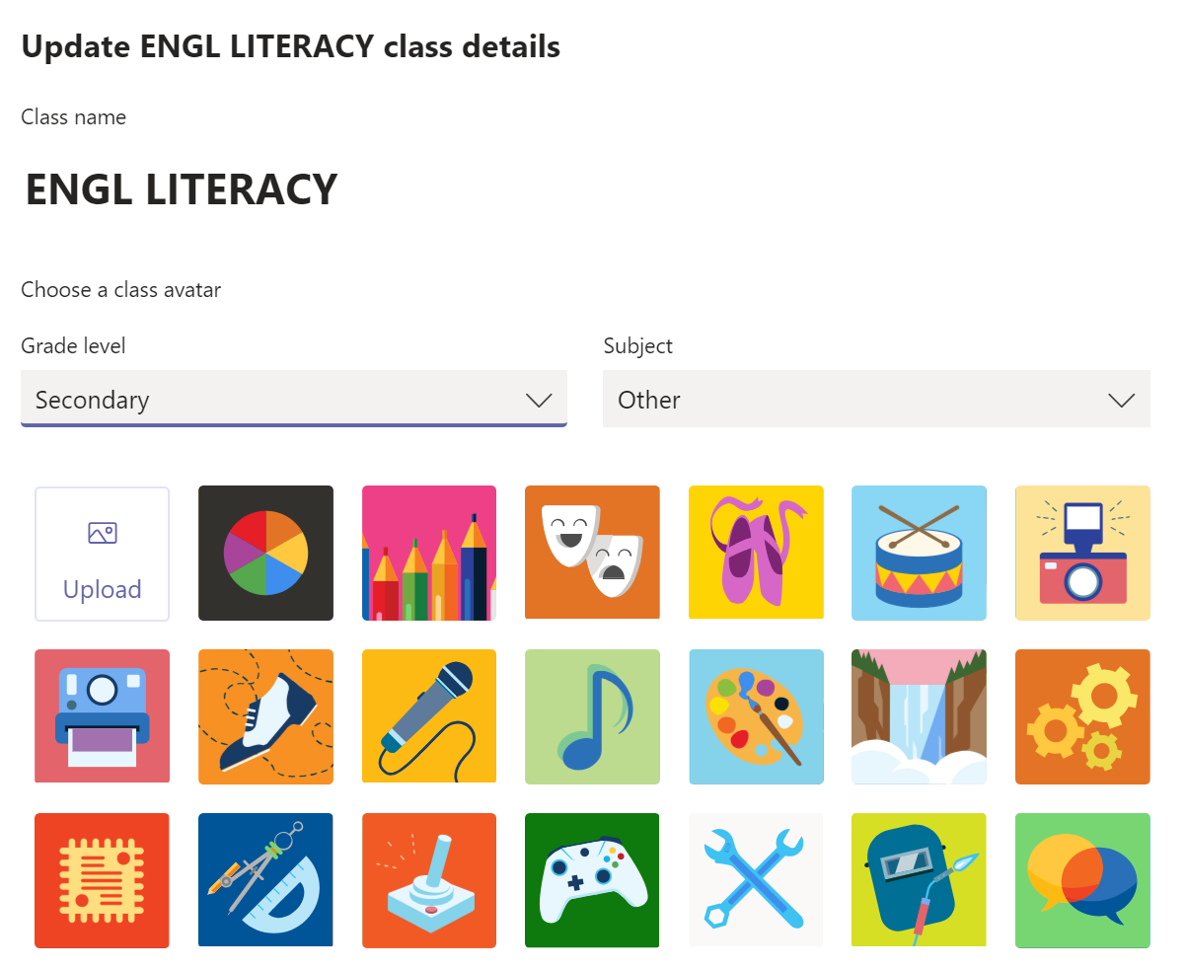
Changing Team Name and Adding an Icon
Notes:
Then you can change the name or add the term and hour to help you differentiate your classes. You can also choose a different icon for those visual learners. (although I couldn’t get this to work this year so I will have to check with Dave if others can’t get it to work.)

Slide 7

Add a Student or Teacher
New Student, Co-Teacher, or Special Ed Teacher Can Be Added
Notes:
Any new students, co-teachers or special ed teachers have to be added by hand. If Dave were to run an update for new students, he would wipe everyone’s assignments or conversations that they have already put in. When you have clicked on the class, look for those three magic dots again. Choose “add member.”

Slide 8
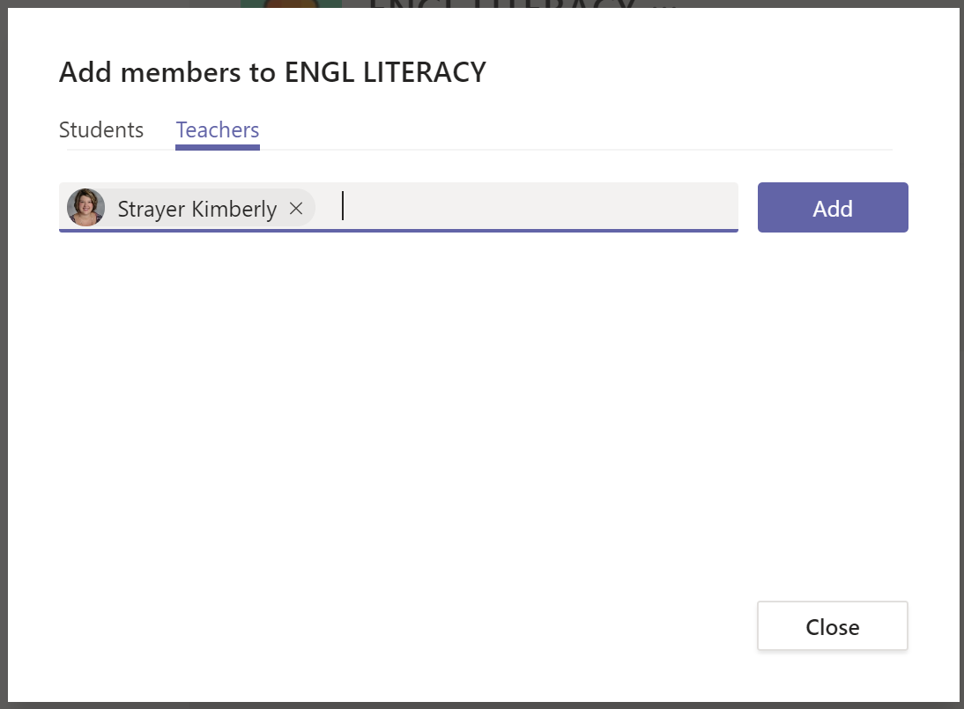

Type in name and Teams will find them
Notes:
Choose the student or teacher tab. Type in the name of the new student or teacher and if he or she has a school email, the name should pop up. Select “add” and the person is now a part of your class.

Slide 9
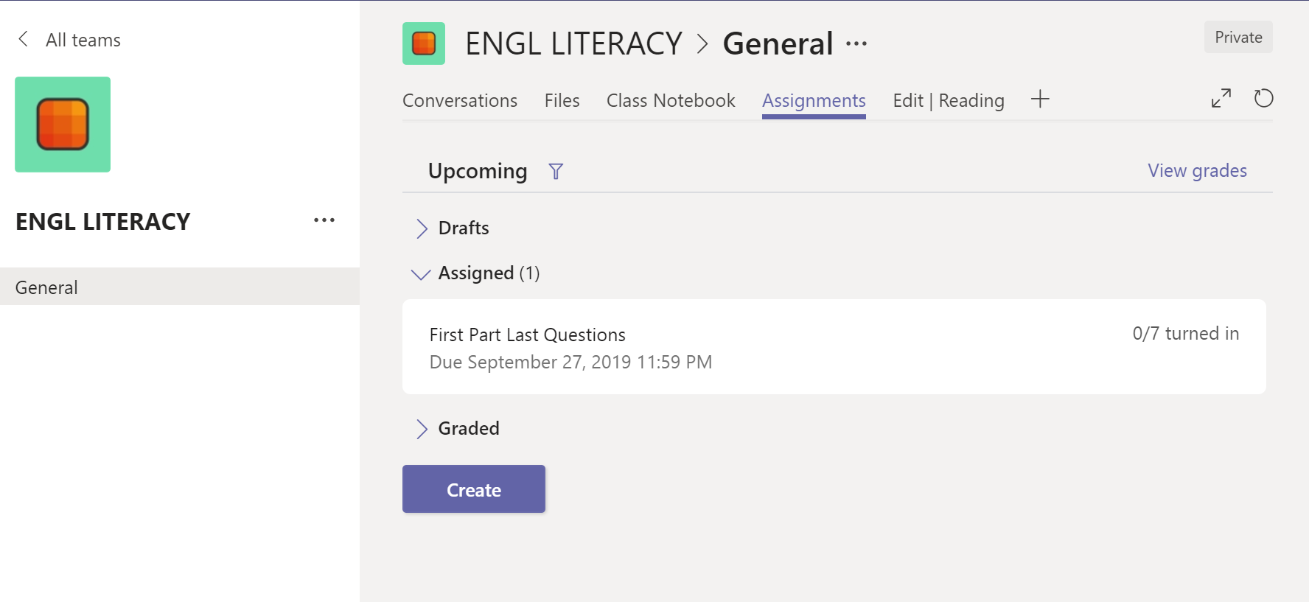
Add Assignment
Add assignments by clicking “Create.”
You can add a quiz or assignment.
Notes:
If you want to put in an assignment, simply click the “create” button. You can add an assignment or a quiz from your One Drive.

Slide 10
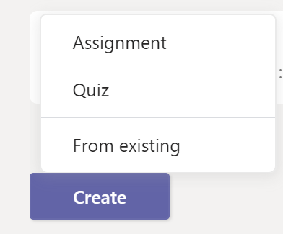
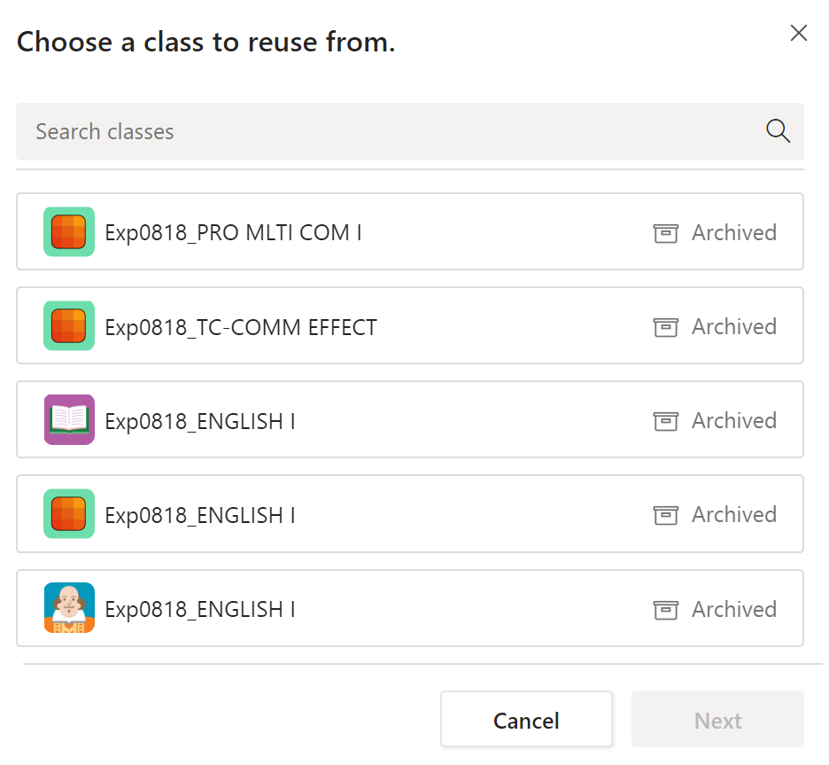

Reuse assignments from an archived class
Notes:
Now you can also reuse an assignment from an archived class, which means classes from previous years. You choose “create” and “from existing.” It will then show all of your archived classes.

Slide 11
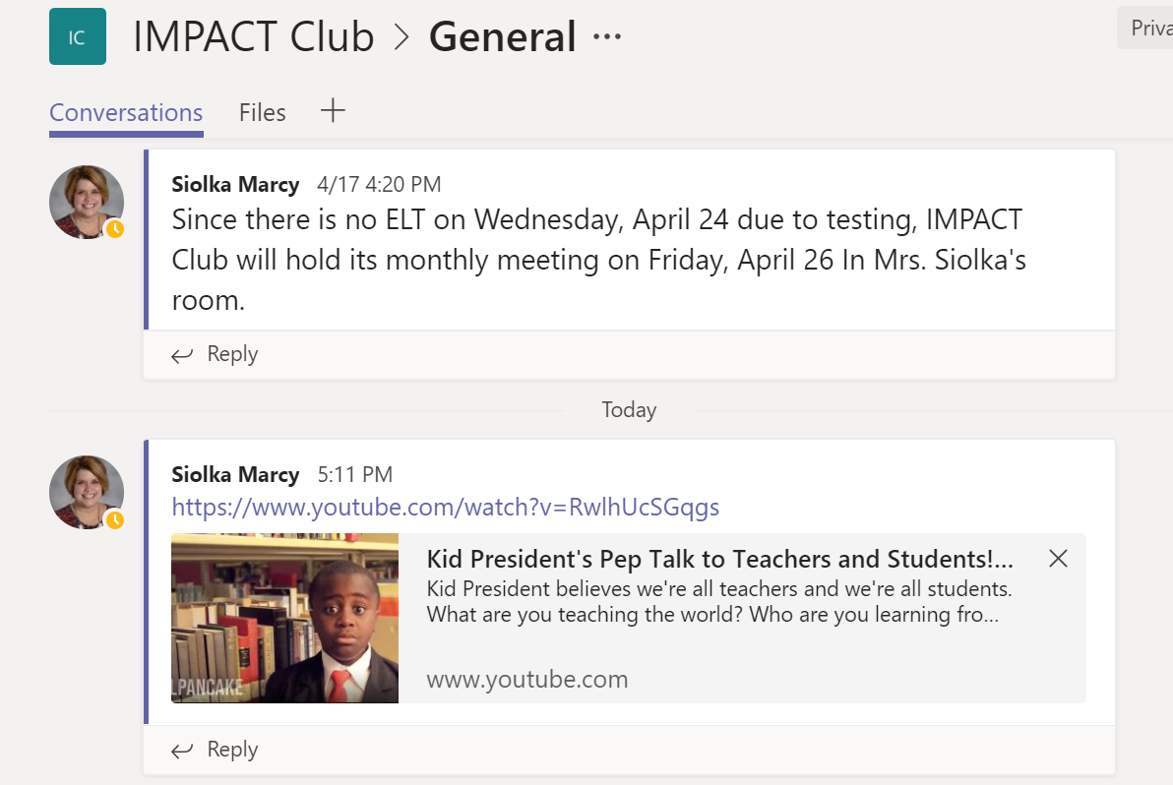
Send Message, Files, and Links to Your Class
Send messages, files, assignments, and links through the conversation tab
Notes:
You can also upload messages, files, links, and assignments through the conversation tab. Just remember that students have to download the file or assignment before they can type in it. Otherwise they will be typing over each other in a shared document.

Slide 12
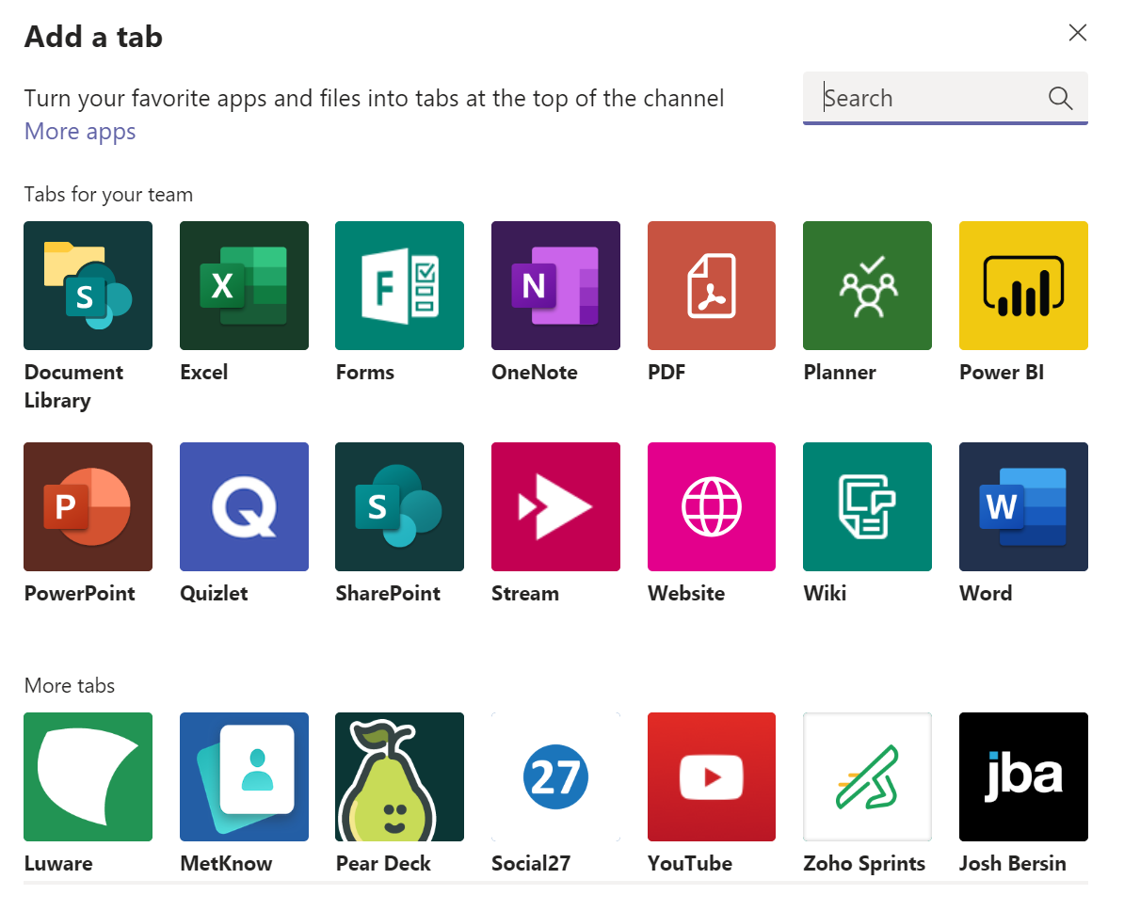
Add Favorite Apps and Files as a Tab
Notes:
You can add a tab at the top of your class page for apps that you use often like quizlet, pear deck, or forms.

Slide 13
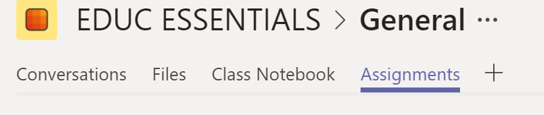
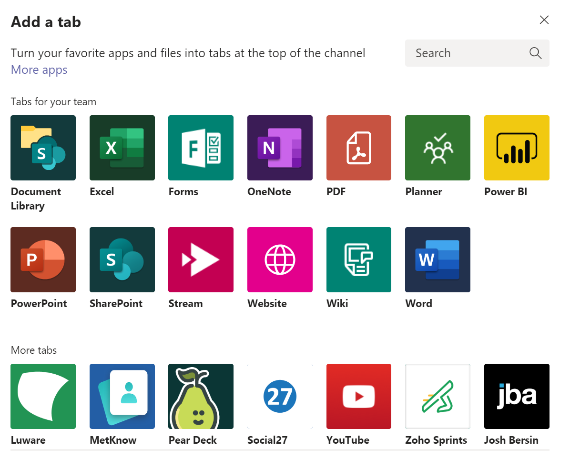
Forms
Click “+”and add Forms
  Use forms for grading, feedback, and scores
Notes:
If you wanted to add Forms, click the “+” and choose the Forms app.

Slide 14
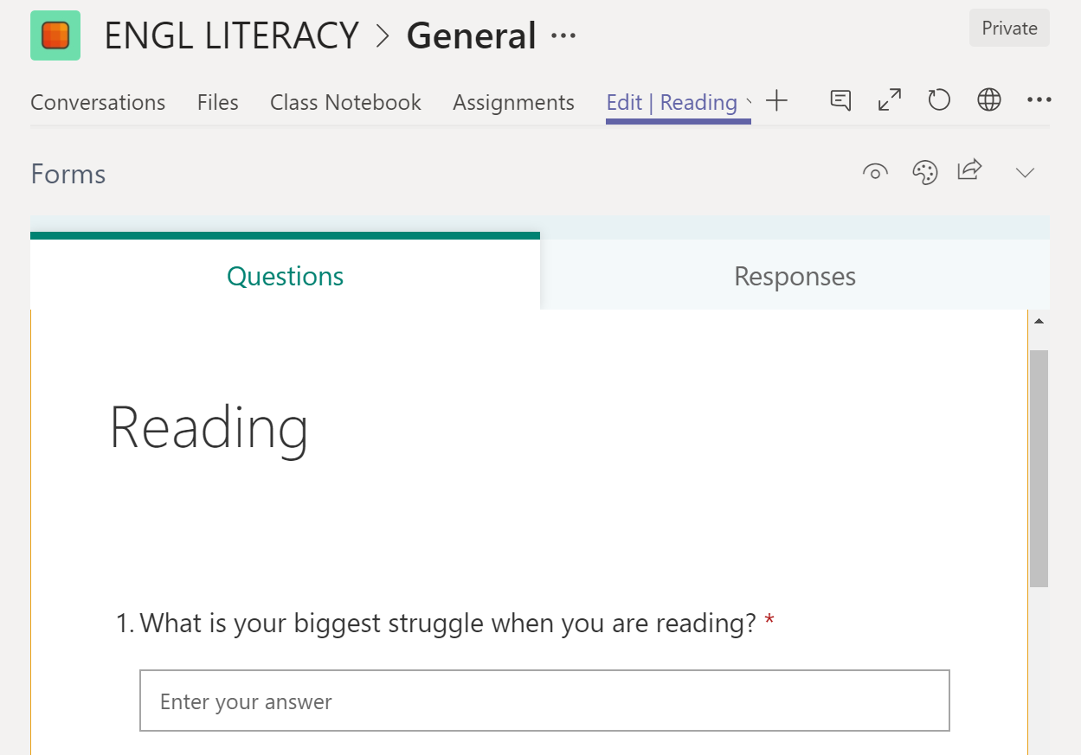
Example of Forms
Notes:
You can use forms to gather information from your students, make quizzes, surveys and polls.

Slide 15
Coming soon:
Weekly Assignment Progress
Email digest for parents and guardians
  Quick look at the previous week’s assignment progress
  Missing assignments
  Upcoming assignments
Notes:
Teams has recently rolled out a progress report to send to parents. We need to find out a little more to set this up and explore if this is something our teachers would be interested in trying.

Slide 16

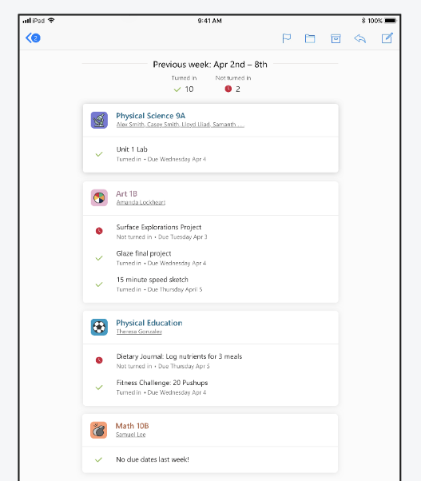
Example of
Email Digest
Notes:
This is an example of an email digest progress report.

Slide 17
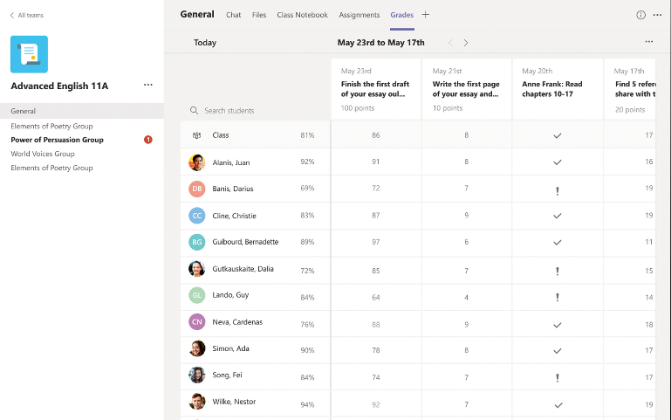
Coming Soon: Gradebook
Assignments can be graded in Teams
Scores will sync in Skyward
Notes:
A gradebook will also be coming in the next year. You will be able to grade your assignments right in Teams and the scores will Sync to Skyward.

